Slide 1
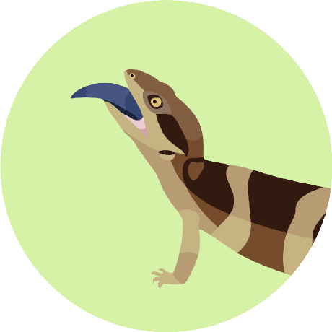


INTRODUCING:
THE ADAPTIVE LANDSCAPE
Ian Brennan
Teaching Presentation
Notes:
Today I’d like to introduce to you one of the most common and valuable ideas in evolutionary biology, the adaptive landscape. Like lots of popular ideas in science, the adaptive landscape is a metaphor, but it’s one that helps to link entire realms of biology (both in theory and history) and is one you’re likely to come across again and again. For this reason, it’s worthwhile to spend a little time on the idea.

Slide 2

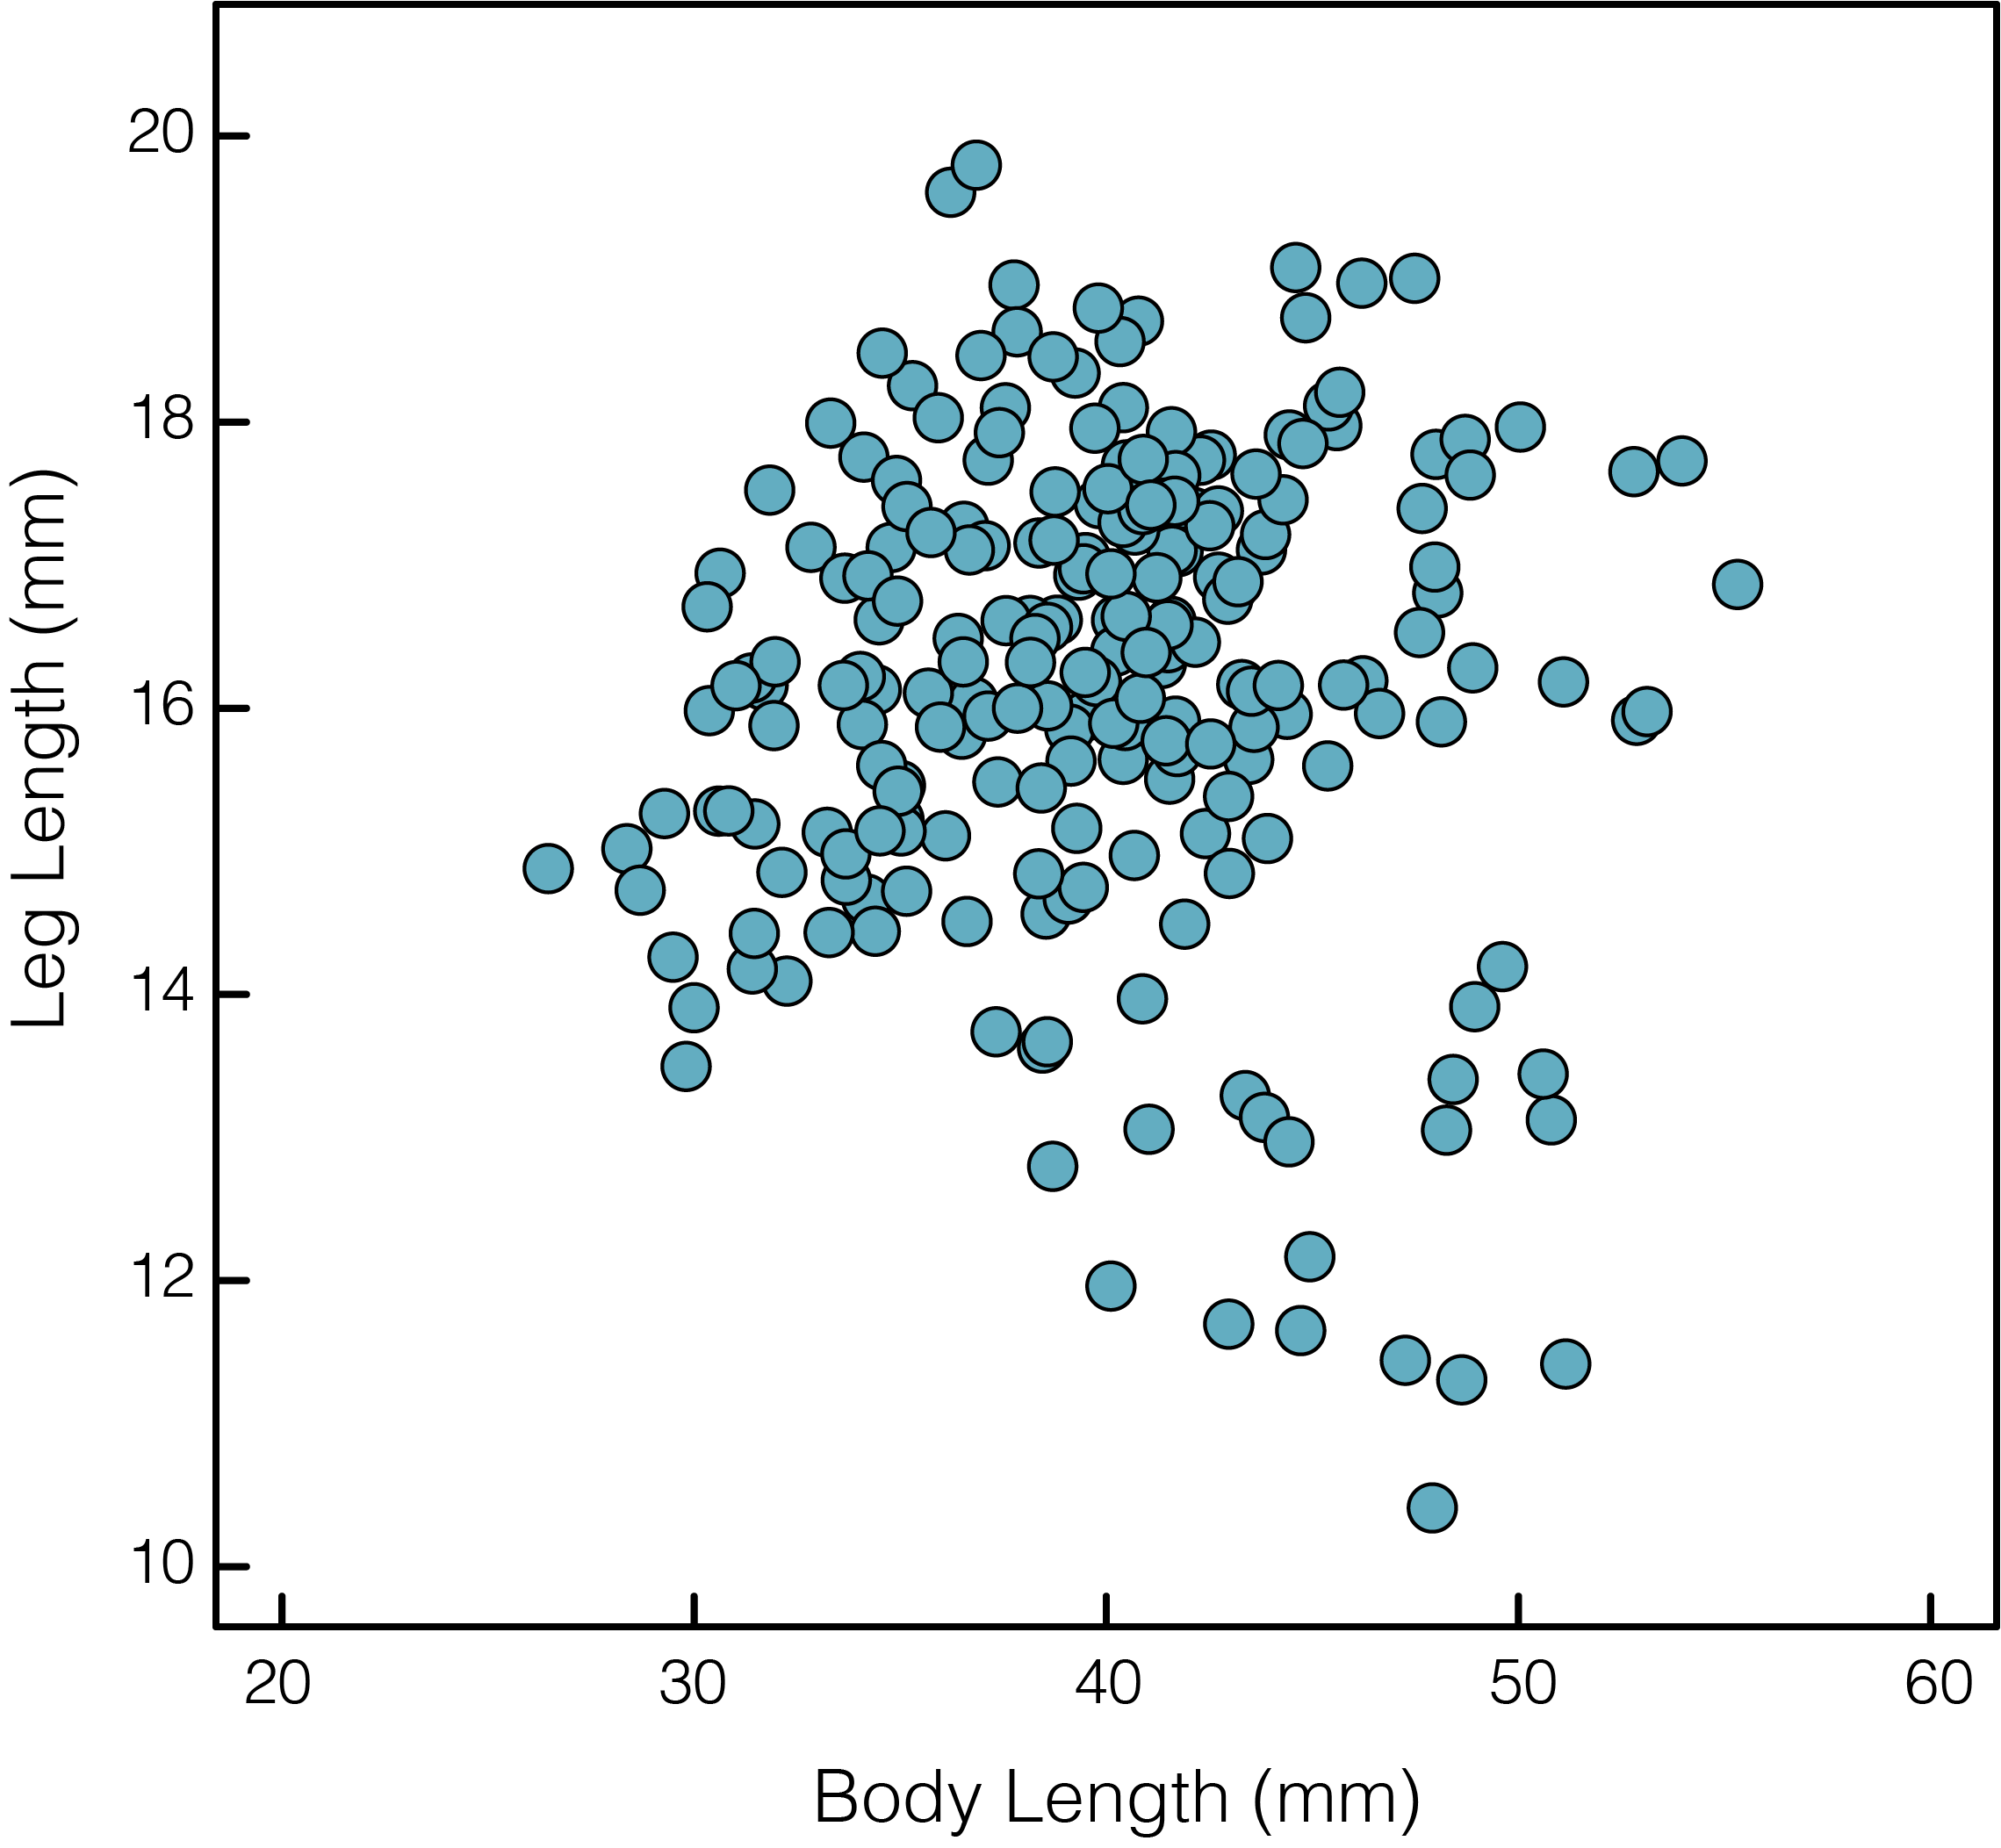
2023
CATCH
MEASURE
RECORD
individual frog
Notes:
Before trying to define the idea, let’s illustrate it first.
Let’s imagine it’s a beautiful summer long ago (2023), and we’ve spent each night of the summer going out into our local park and catching frogs and recording some basic measurements, say we focused on measuring the length of the legs and the body length, because these are things that are indicative of jumping performance (how far a frog can jump). We did pretty well going out a lot of nights and managed to measure 250 individual frogs just in the one population we looked at.

Slide 3
2023
CATCH
MEASURE
RECORD
individual frog
Notes:
From looking at the plot of leg length against body length, it looks like the distribution of these traits isn’t completely uniform. There’s a lot more frogs in the highlighted box, and far fewer out on the edges.

Slide 4
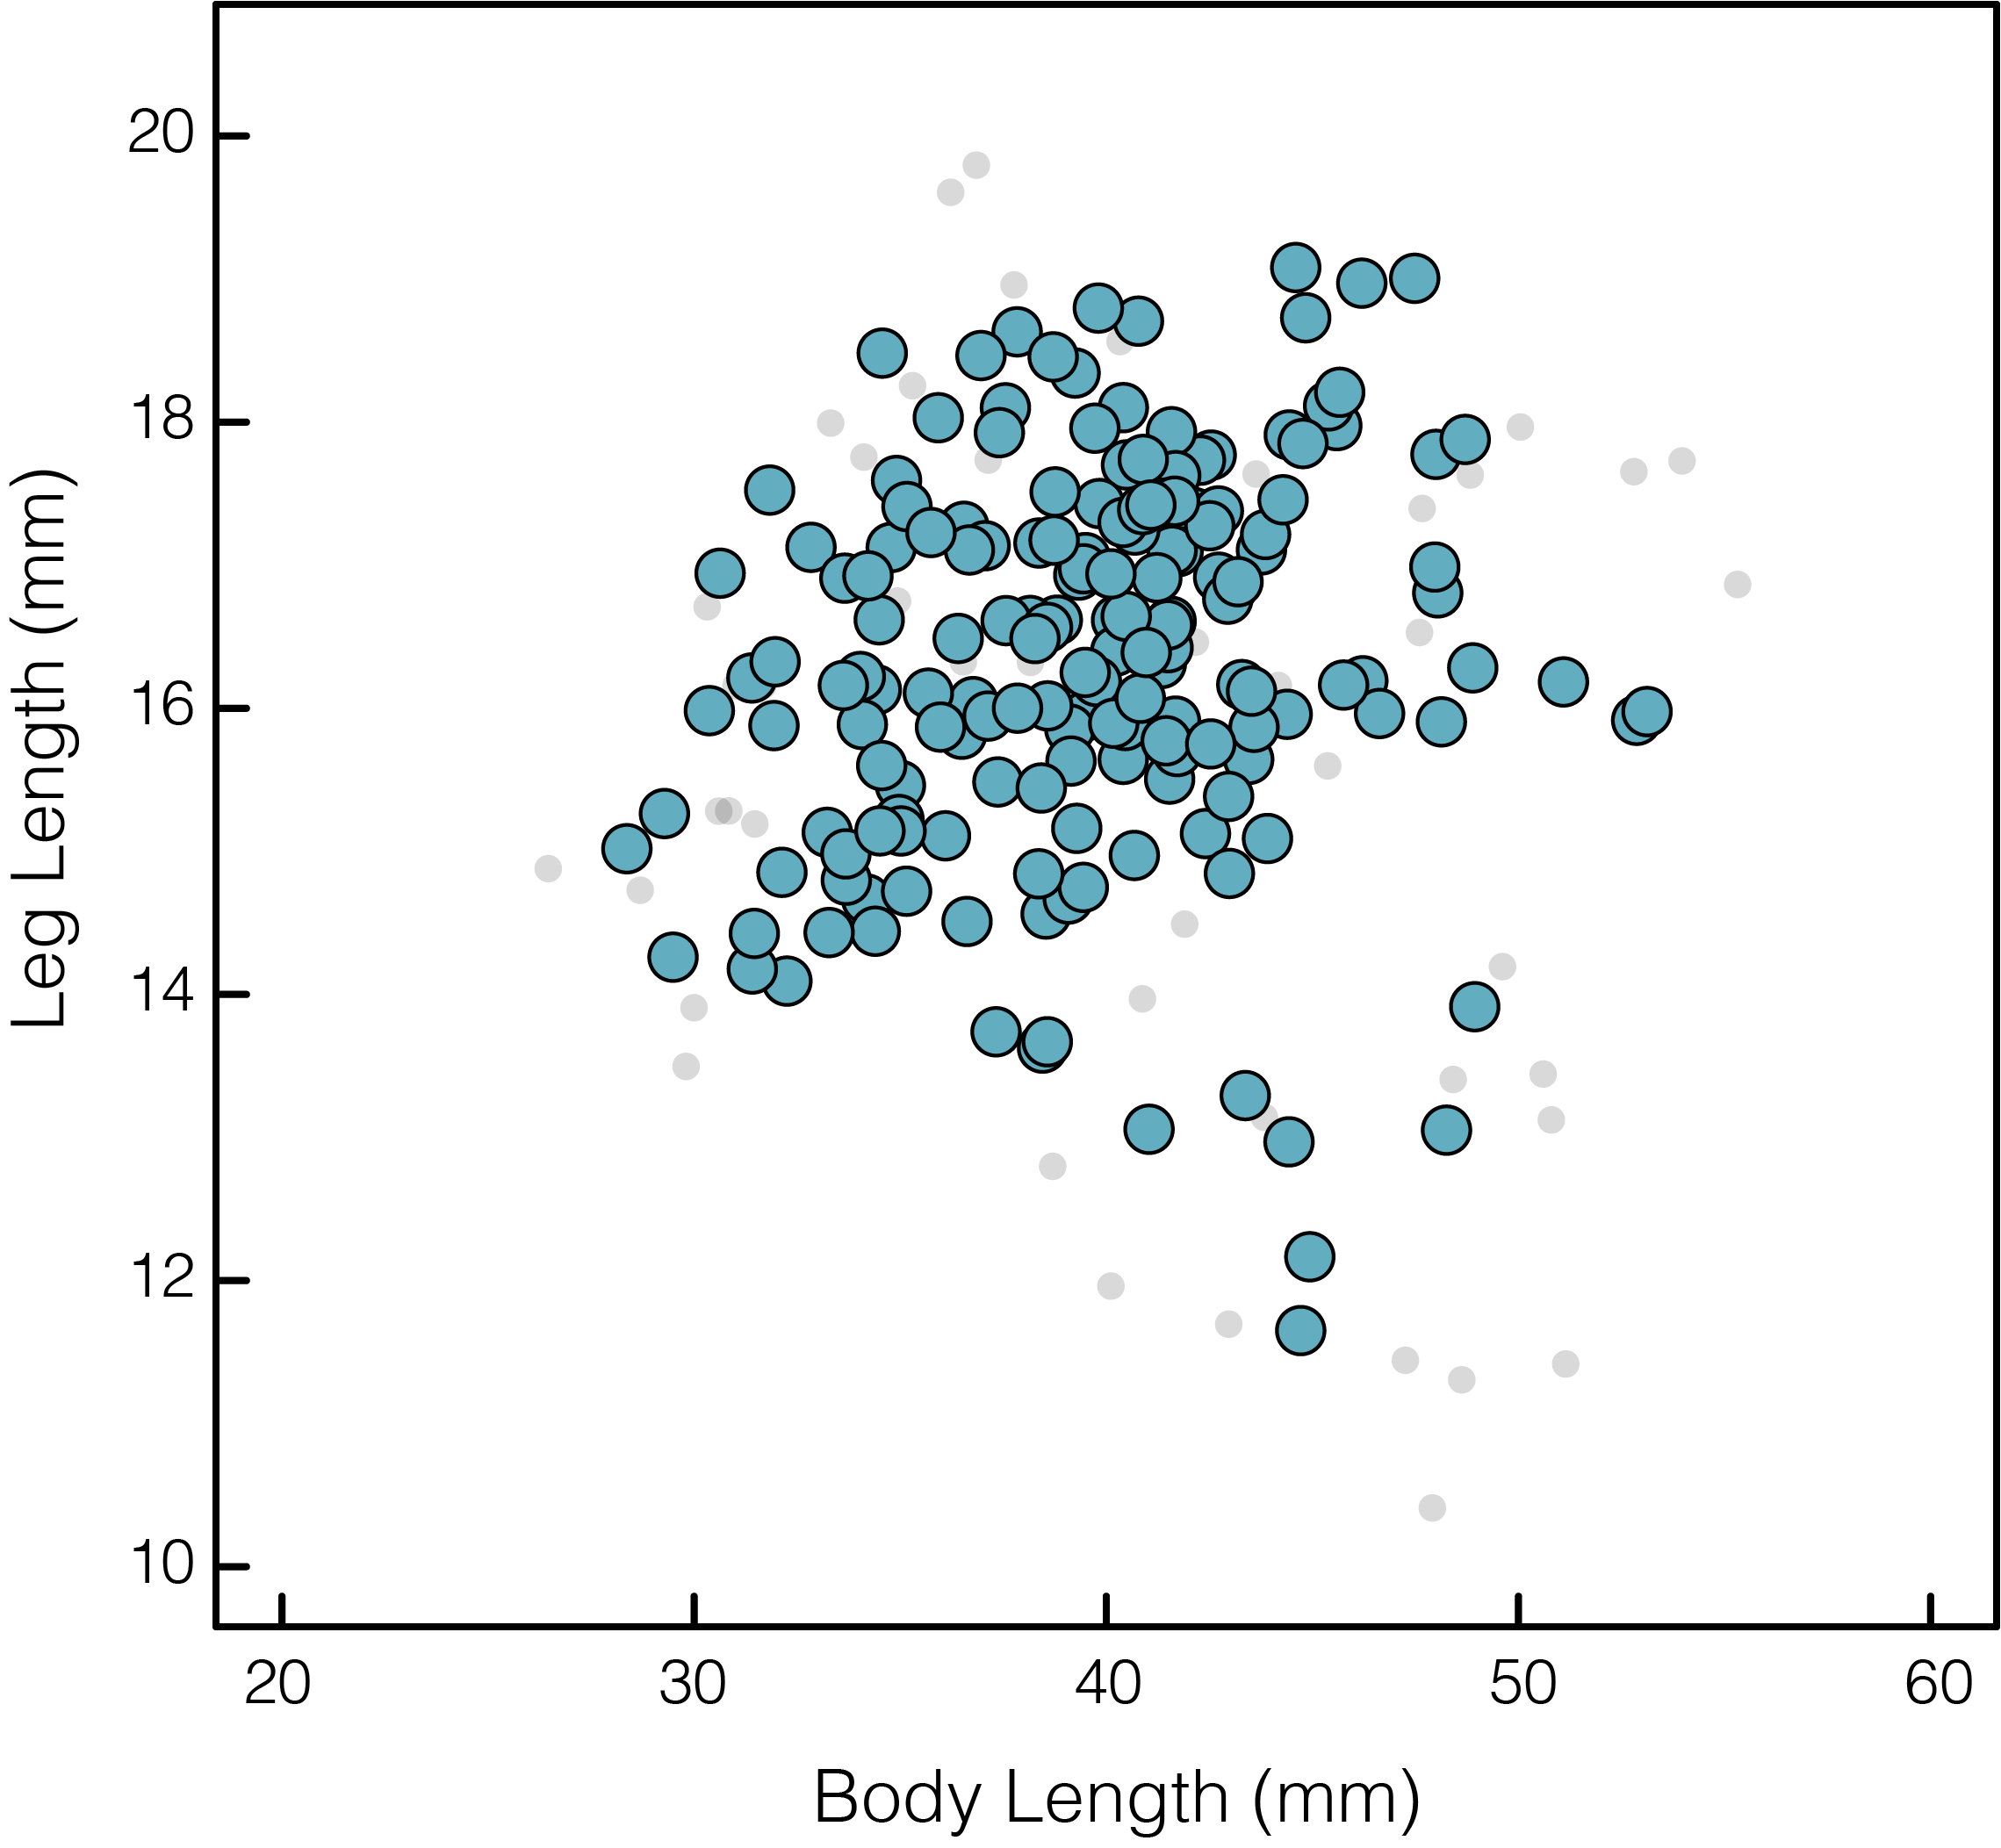
2024
RECATCH
…
RECORD
SURVIVORS
survived
died
Notes:
Now the summer of 2024 rolls around and we head back out into our park and look for all those same frogs. Of the 250 frogs we initially caught, we’re only able to find 180 of them, and we assume the other 70 frogs didn’t survive, let’s say they were eaten by birds or snakes or fish, or died for whatever reason.

Slide 5
2024
RECATCH
…
RECORD
SURVIVORS
survived
died
Notes:
We can look at the distribution of those surviving frogs and see that the distribution of non-survivors isn’t uniform either. More frogs on the fringes of the plot died, than we would’ve expected assuming an equal survival probability.

Slide 6
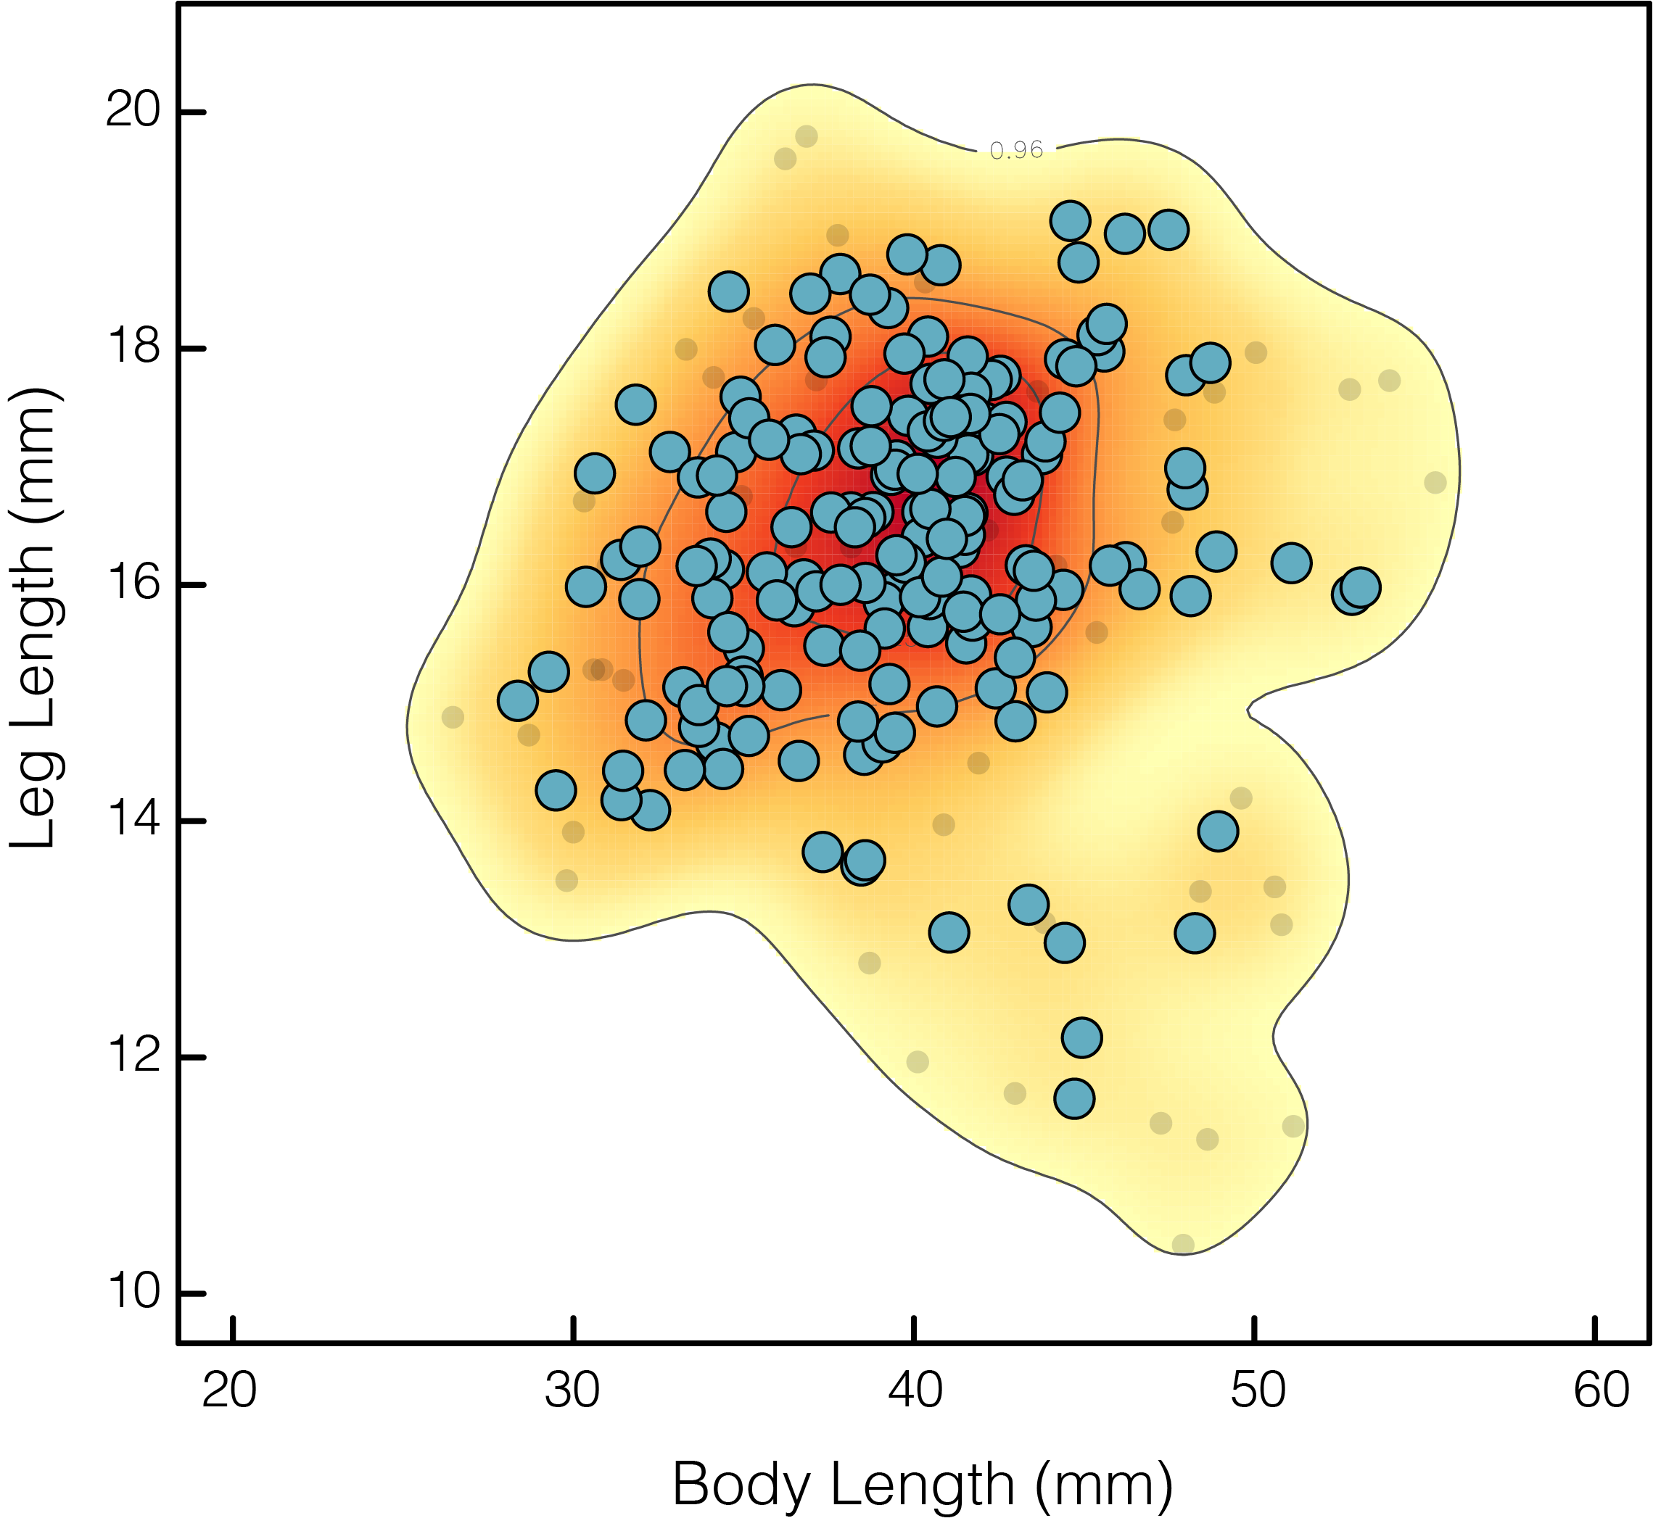
WHO SURVIVED?
WHO DIDN’T?
IS THERE A BIAS?
survived
died
Notes:
We can visualize that survival likelihood as a heatmap and plot it behind the points. This is useful because if we caught a frog on a given day we could now tell based solely on its morphology if it is likely to have a high or low chance of survival, from this year to the next.

Slide 7
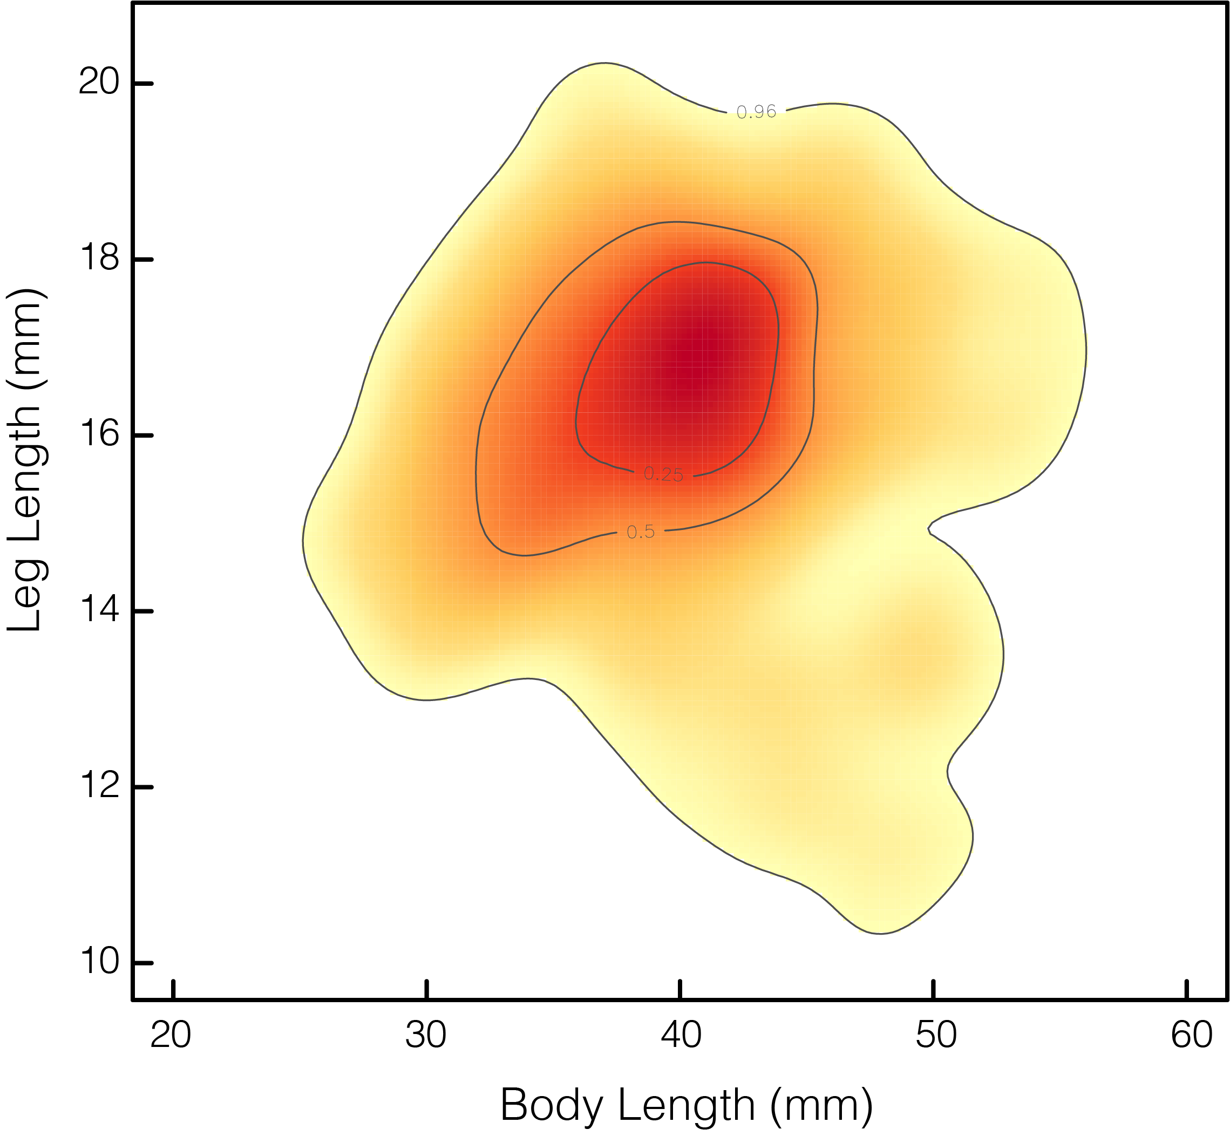
SURVIVAL
AS A PROXY
FOR FITNESS OR PERFORMANCE
high survival
low survival
Notes:
Imagine this as a volcano or a mountain.
What we’ve done is build an adaptive landscape of this population of frogs, where the cardinal directions (e.g. North, South, East, West) are combinations of traits and the topography is fitness or performance, or something else we might be interested in.

Slide 8
TRAITS MAP TO A LANDSCAPE
WHERE THE CONCENTRATION OF POINTS INDICATES AN ADAPTIVE PEAK
high survival
low survival
Notes:
What we’ve done is build an adaptive landscape of this population of frogs, where the cardinal directions (e.g. North, South, East, West) are combinations of traits and the topography is fitness or performance, or something else we might be interested in.

Slide 9
HELLO
ADAPTIVE LANDSCAPE
high survival
low survival

Slide 10
Bivariate plot of two common traits in a single species
E.g. leg ~ SVL in Lampropholis
Good sampling of individuals
Distribution of traits is reflective of population variation
Do we see an uneven distribution of trait variances?

Slide 11
Funspace bivariate plot of two common traits in a single species
E.g. leg ~ SVL in Lampropholis, with heatmap
Distribution is not even, points are clustered

Slide 12
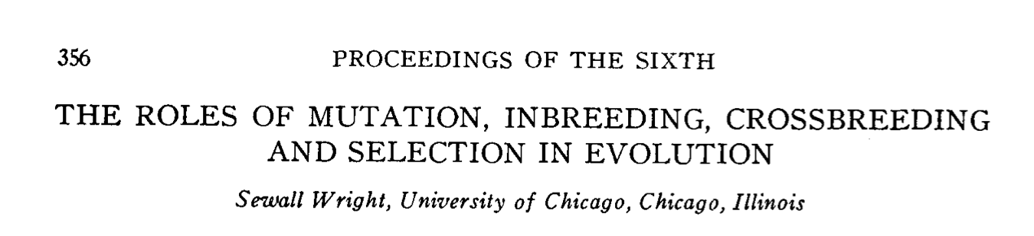
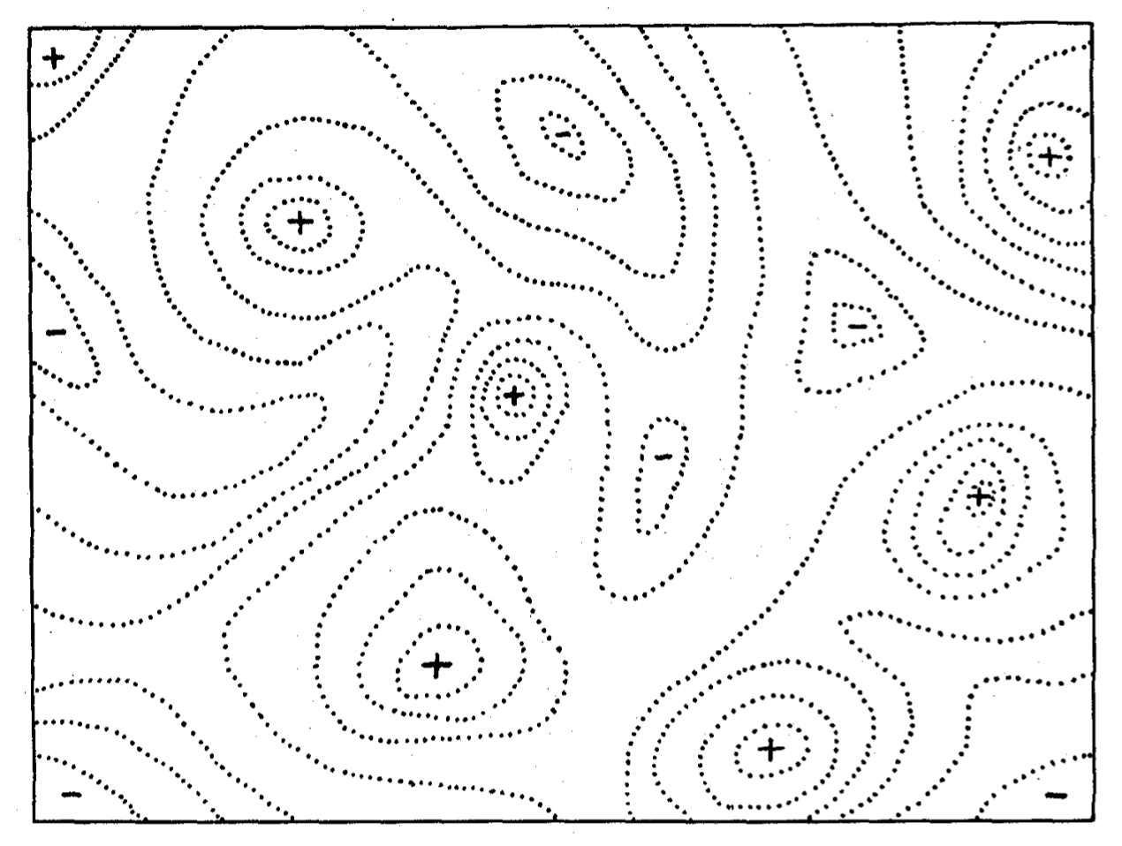
Wright (1932) introduced the idea of evolutionary spaces
____________

Slide 13
Wright (1932) introduced the idea of evolutionary spaces
____________
A topographic map of gene combinations
think “bird’s eye view”

Slide 14
Wright (1932) introduced the idea of evolutionary spaces
____________
A topographic map of gene combinations
Some areas are heavily occupied (peaks)

Slide 15
Wright (1932) introduced the idea of evolutionary spaces
____________
A topographic map of gene combinations
Some areas are heavily occupied (peaks)
Some areas are seldom occupied (valleys)
Notes:
What’s important to grasp is that the observed gene or trait frequencies are a reflection of the landscape and not the landscape itself. They are dictated

Slide 16
Wright (1932) introduced the idea of evolutionary spaces
____________
peaks = higher fitness
valleys = lower fitness
descriptive … but testable!
Genotypic Axis 2
Genotypic Axis 1

Slide 17
AN EVOLVING CONCEPT
WRIGHT (1932)
→ GENETICS
Notes:
What makes the adaptive landscape so enduring is ...
This idea, that we can think of combinations of traits as indicative of fitness was so clever and useful that it spawned extensions in paleontology and ecology.

Slide 18
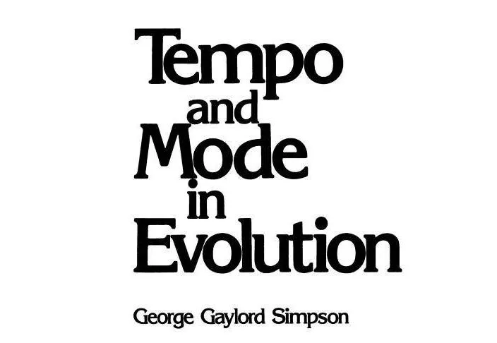
AN EVOLVING CONCEPT
WRIGHT (1932)
→ GENETICS
SIMPSON (1944) → MORPHOLOGY

Slide 19
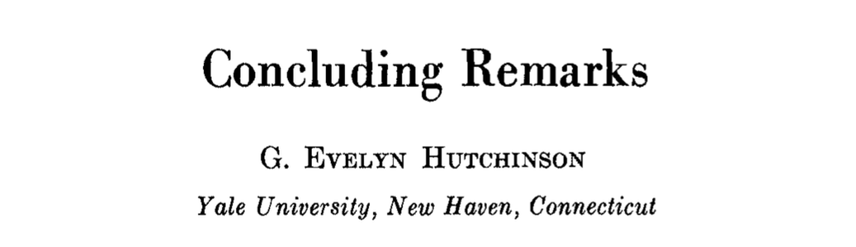
AN EVOLVING CONCEPT
WRIGHT (1932)
→ GENETICS
SIMPSON (1944) → MORPHOLOGY
HUTCHINSON (1957)
→ NICHES

Slide 20
the simplest landscape
is … flat
Leg Length (mm)
Body Length (mm)

Slide 21
the simplest landscape
is … flat
evolution by drift
Leg Length (mm)
Body Length (mm)

Slide 22
once there is an optimum, selection should drive the mean up the hill towards it
Leg Length (mm)
Body Length (mm)

Slide 23
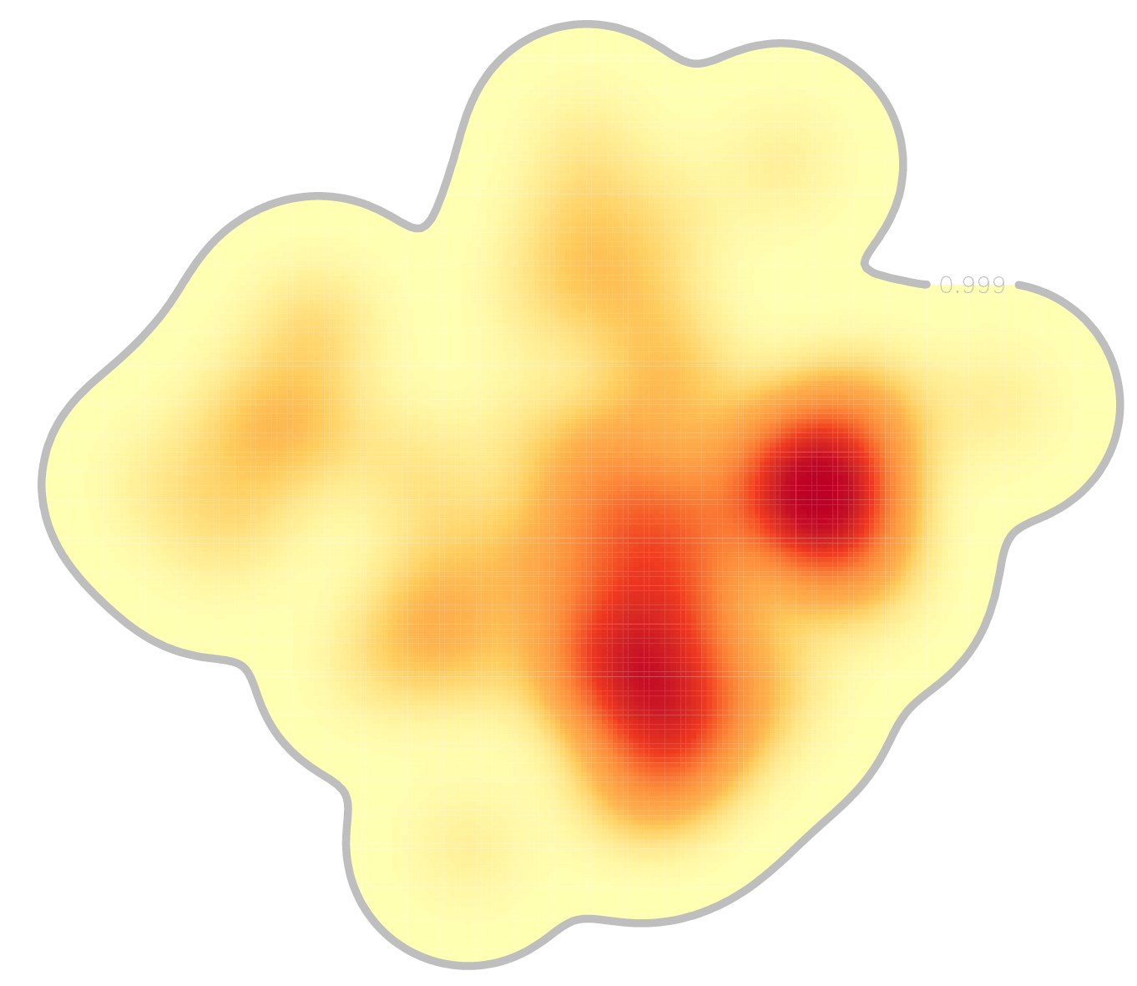
our starting
phenotype
Leg Length (mm)
Body Length (mm)

Slide 24
our target
phenotype
(optimal)
Leg Length (mm)
Body Length (mm)

Slide 25
complex landscapes can have multiple peaks and move along ridges
Leg Length (mm)
Body Length (mm)

Slide 26
we can then measure the strength of that selection and the slope of the landscape
Leg Length (mm)
Body Length (mm)

Slide 27
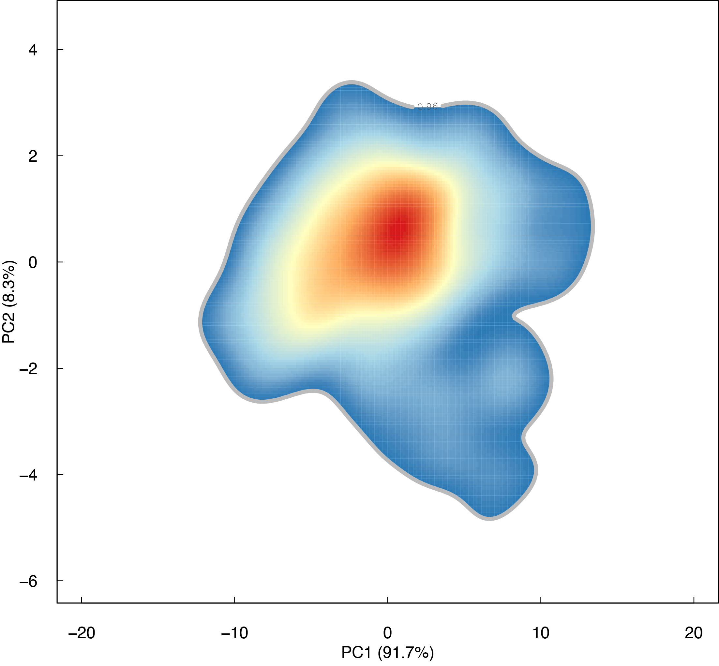
what if things change?
____________
imagine the climate for your frogs has changed and they need to be able to jump farther.
What happens to the landscape?
Leg Length (mm)
Body Length (mm)

Slide 28
the peak can move
____________
peaks can move due to changing environment, opportunity, or …
longer legs for better jumping!
Leg Length (mm)
Body Length (mm)

Slide 29
the peak can move
____________
peaks can move due to changing environment, opportunity, or …
longer legs for better jumping!
Leg Length (mm)
Body Length (mm)

Slide 30
Peaks move!
____________
peaks can move due to changing environment, opportunity, or …
we can also experimentally move across the landscape
Leg Length (mm)
Body Length (mm)

Slide 31
Peaks move!
____________
peaks can move due to changing environment, opportunity, or …
we can also experimentally move across the landscape
to find paths of genotypic or phenotypic selection
Leg Length (mm)
Body Length (mm)

Slide 32
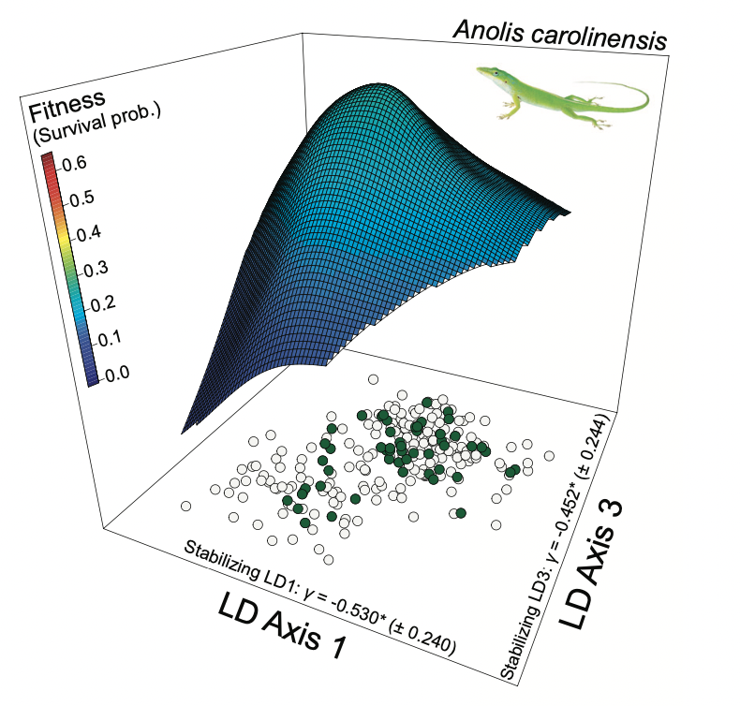
Things to remember about the adaptive landscape
____________
Stroud et al. 2024

Slide 33
Things to remember about the adaptive landscape
____________
multivariate (many axes)
Stroud et al. 2024

Slide 34
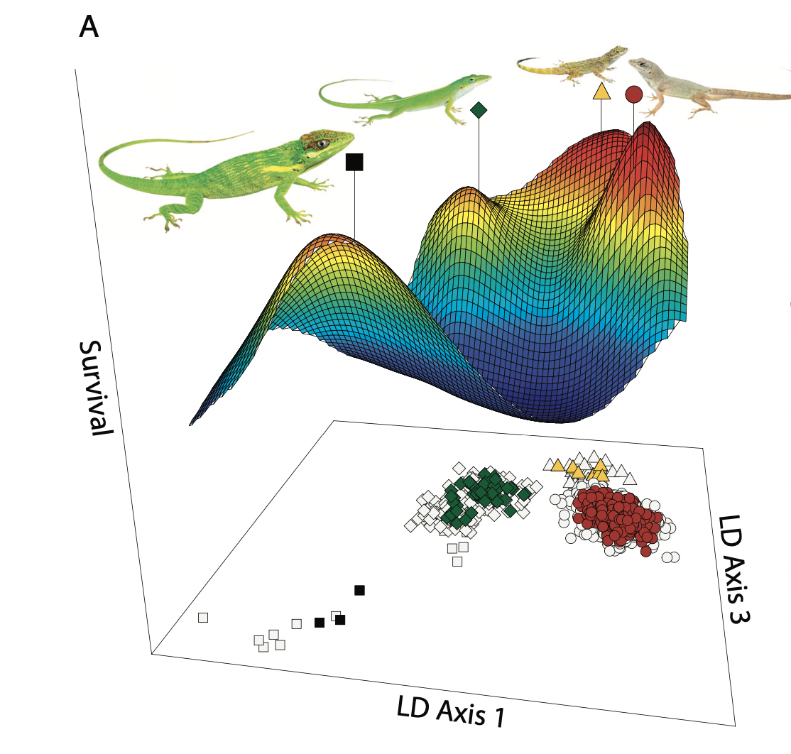
Things to remember about the adaptive landscape
____________
multivariate (many axes)
bridge between micro/macroevolution
Stroud et al. 2024

Slide 35
Things to remember about the adaptive landscape
____________
multivariate (many axes)
bridge between micro/macroevolution
a common language to explain trait change (e.g. selection, drift)
Stroud et al. 2024
Notes:
in our upcoming practical we can play around with this by collecting some data and estimating a landscape

Slide 36
Individuals, populations, or whatever units exist atop the landscape, and do not define it. Meaning the landscape can move, and units ontop must adapt.
Next time, we can talk about how changes to the landscape can result in selection and drive changes in genetics or morphology.

Slide 37
